Slide 1
Recurrence Relations

Slide 2
What is Recurrence Relations?
A recurrence relation is a mathematical expression that defines a sequence in terms of its previous terms
In the context of algorithmic analysis, it is often used to model the time complexity of recursive algorithms.

Slide 3
What is Linear Recurrence Relation?
In a linear recurrence relation, each term in the sequence is a linear combination of previous terms.
General form: where, c1, c2, …, ck are constants and F(n) is a function.

Slide 4
How to Solve Recurrence Relations?
Substitution Method
Recurrence Tree Method
Master Method

Slide 5
Substitution method
T(n) = T(n-1) + n for n > 0 and T(0) = 1
T(n) = T(n-1) + n
= T(n-2) + (n-1) + n
= T(n-k) + (n-(k-1))….. (n-1) + n
Substituting k = n, we get
T(n) = T(0) + 1 + 2+….. +n = n(n+1)/2 = O(n^2)

Slide 6
Example 2
T(n) = T(n/2) + 1 where T(n) is the time required for binary search in an
array of size n
. T(n) = T(n/(2^k)) + 1 + · · · + 1
k = log n, means 1 + 1 + 1+ …. log n times
T(n) = log n

Slide 7
2. Recurrence Tree Method
In this method, we draw a recurrence tree and calculate the time taken by every level of the tree. Finally, we sum the work done at all levels.
For example, consider the recurrence relation
T(n) = T(n/4) + T(n/2) + c(n^2)

Slide 8
c(n^2)
/ \
T(n/4) T(n/2)
If we further break down the expression T(n/4) and T(n/2),
we get the following recursion tree.

Slide 9
c(n^2)
/ \
c(n^2)/16 c(n^2)/4
/ \ / \
T(n/16) T(n/8) T(n/8) T(n/4)

Slide 10
Breaking down further gives us following
c(n^2)
/ \
c(n^2)/16 c(n^2)/4
/ \ / \
c(n^2)/256 c(n^2)/64 c(n^2)/64 c(n^2)/16
/ \ / \ / \ / \

Slide 11
To know the value of T(n), we need to calculate the sum of tree nodes level by level. If we sum the above tree level by level,
we get the following series T(n) = c(n^2 + 5(n^2)/16 + 25(n^2)/256) + ….
The above series is a geometrical progression with a ratio of 5/16.
To get an upper bound, we can sum the infinite series. We get the sum as (n^2)/(1 – 5/16) which is O(n^2)

Slide 12
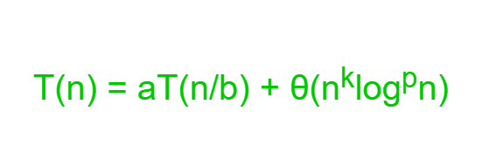
Master Method
where n = size of the problem
a = number of subproblems in the recursion and a >= 1
n/b = size of each subproblem
b > 1, k >= 0 and p is a real number

Slide 13
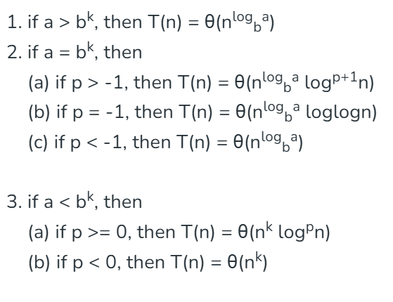
Then,

Slide 14
Example 1
T(n) = T(n/2) + O(1)
a = 1, b = 2, k = 0 and p = 0
b^{k} = 1. So, a = b^{k} and p > -1 [Case 2.(a)]
T(n) = θ(n^{log}_{b}ª log^{p+1}n)
T(n) = θ(logn)

Slide 15
Practice
https://www.geeksforgeeks.org/recurrence-relations-notes-for-gate-exam/

